Slide 1
Chapter 2
Introducing Data Types
and Operators
李晔锋

Slide 2
Key Skills & Concepts
Know Java’s primitive types
Use literals
Initialize variables
Know the scope rules of variables within a method
Use the arithmetic operators
Use the relational and logical operators
Use shorthand assignments
Understand type conversion in assignments
Cast incompatible types
Understand type conversion in expressions

Slide 3
Java’s Primitive（原始） Types
Type | Meaning
boolean | Only have true/false values
byte | 8-bit integer
char | Character
double | Double-precision floating point
float | Single-precision floating point
int | Integer
long | Long integer
short | Short integer

Slide 4
Integer
Type | Width in Bits | Range
byte | 8 | -2⁷ to 2⁷-1
short | 16 | -2¹⁵ to 2¹⁵-1
int | 32 | -2³¹ to 2³¹-1
long | 64 | -2⁶³ to 2⁶³-1

Slide 5
Floating-Point Types
public class Hypot {
public static void main(String[] args) {
// TODO Auto-generated method stub
double x,y,z;
x=3;y=4;
z = Math.sqrt(x*x + y*y);
System.out.println("Hypotenuse is " + z);
}
}

Slide 6
Characters
Java uses Unicode which defines a character set that can represent all the characters found in all human languages.
In Java, char is an unsigned 16-bit type having a range of 0 to 65535.
A char can be assigned a short integer value.

Slide 7
The char Example
public class CharArithDemo {
public static void main(String[] args) {
// TODO Auto-generated method stub
char ch;
ch = 'X’;
System.out.println("ch contains " + ch);
ch++; //increment ch
System.out.println("ch is now " + ch);
ch = 90; // give ch the value Z
System.out.println("ch is now " + ch);
}
}

Slide 8
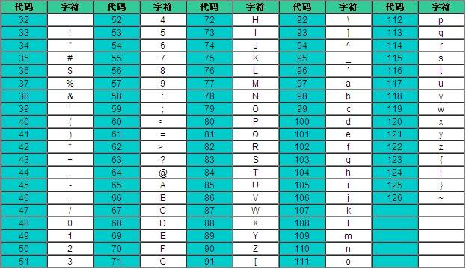
The ASCII Code Table

Slide 9
The Boolean Type
public class BoolDemo {
public static void main(String[] args) {
// TODO Auto-generated method stub
boolean b;
b = false;
System.out.println("b is " + b);
b = true;
System.out.println("b is " + b);
//a boolean value can control the if statement
if(b) System.out.println("This is excuted");
b = false;
if(b) System.out.println("This is not executed");
//outcome of a relational operator is a boolean
System.out.println("10 > 9 is " + (10 > 9));
}
}

Slide 10
Literals（直接量）
In Java, literals refer to fixed values that are represented in their human-readable form.
Literals are also commonly called constants.
Java literals can be any of the primitive data types.
123, ‘a’, 999999L, 0.56, …

Slide 11
Hexadecimal, Octal and Binary Literals
Hexadecimal literals
Starting with 0x, such as 0xFF.
Octal literals
Starting with 0, such as 012.
Binary literals
Starting with 0b, such as 0b1010.

Slide 12
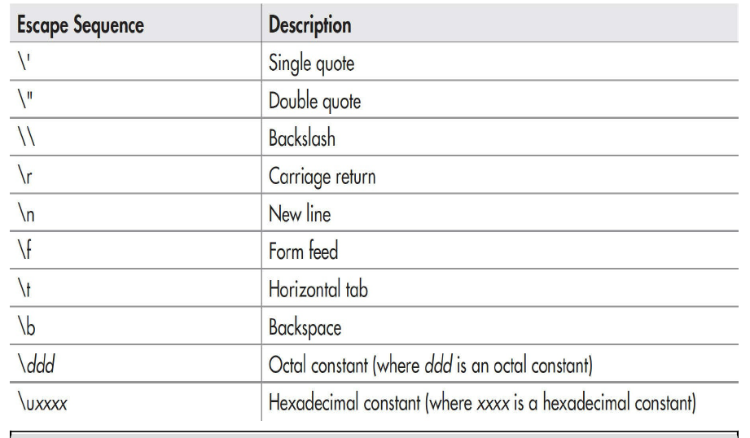
Character Escape Sequences（转义字符）

Slide 13
String Literals
public class StrDemo {
public static void main(String[] args) {
// TODO Auto-generated method stub
System.out.println("First line\nSecond line");
System.out.println("A\tB\tC");
System.out.println("D\tE\tF");
System.out.println("\"Hello World!\"");
}
}

Slide 14
Initializing a Variable
Giving an initial value to a variable when it is declared:
int count = 10;
char ch = ‘X’;
float f = 1.2F
int a, b = 8, c = 19, d;

Slide 15
Dynamic Initialization
public class DynaInit {
public static void main(String[] args) {
// TODO Auto-generated method stub
double radius = 4,height = 5;
//dynamically initialize volume
double volume = 3.1416 * radius * radius * height;
System.out.println("Volume is " + volume);
}
}

Slide 16
The Scope of Variables
A scope is defined by a code block.
Variables declared inside a scope are not visible to code that is defined outside that scope.
Scopes can be nested. The objects declared in the outer scope will be visible to code within the inner scope, but the reverse is not true.

Slide 17
The Scope Demo
public class ScopeDemo {
public static void main(String[] args) {
// TODO Auto-generated method stub
int x = 10; //known to all code within main
if(x == 10) { //start new scope
int y = 20; //know only to this block
//x and y both known here
System.out.println("x and y: " + x + " " + y);
x = y * 2;
}
//y = 100; //Error! y not known here
//x is still known here
System.out.println("x is " + x);
}
}

Slide 18
The Lifetime of Variables
Variables are created when their scope is entered, and destroyed when their scope is left.
If a variable declaration includes an initializer, the variable will be reinitialized each time the block in which it is declared is entered.

Slide 19
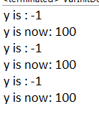
The Lifetime of Variables
public class VarInitDemo {
public static void main(String[] args) {
// TODO Auto-generated method stub
int x;
for(x = 0; x < 3; x++) {
int y = -1; //y is initialized each time block is enter
System.out.println("y is : " + y);
y = 100;
System.out.println("y is now: " + y);
}
}
}

Slide 20
Operators
Arithmetic operators
Relational operators
Bitwise operators
Logical operators
Other operators

Slide 21
Arithmetic Operators
+ | Addition
- | Subtraction
* | Multiplication
/ | Division
% | Modulus
++ | Increment
-- | Decrement

Slide 22

Increment and Decrement
public class IncDemo {
public static void main(String[] args) {
// TODO Auto-generated method stub
int x1 = 10, x2 = 10, y1, y2;
y1 = ++x1;
y2 = x2++;
System.out.println("x1= " + x1);
System.out.println("y1= " + y1);
System.out.println("x2= " + x2);
System.out.println("y2= " + y2);
}
}

Slide 23
Relational Operators
< | Less than
<= | Less than or equal
> | Greater than
>= | Greater than or equal
== | Equal to
!= | Not equal

Slide 24
Logical Operators
& | AND
| | OR
^ | XOR(异或)
|| | Short-circuit OR
&& | Short-circuit AND
! | NOT

Slide 25
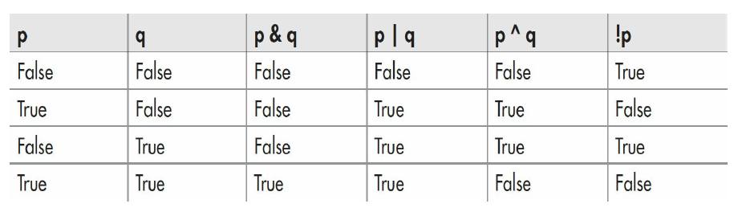
The Truth Table

Slide 26
Short-Circuit Logical Operators
Short-circuit logical operators just evaluate part of the operands when necessary.
int x = -1;
if(x>0 && x<5) …
The above example will not judge “x<5” as the former “x>0” is false.

Slide 27
Short-Circuit Logical Operators Example
public class SCops {
public static void main(String[] args) {
// TODO Auto-generated method stub
int n,d,q;
n = 10; d = 2;
if(d != 0 && (n%d) == 0)
System.out.println(d + " is a factor of " + n);
d= 0; //now, set d to zero
//Since d is zero, the second operand is not evaluated
if(d != 0 && (n%d) == 0)
System.out.println(d + " is a factor of " + n);
/*Now, try same thing without short-circuit operator
This will cause a divice-by-zero error*/
if(d != 0 & (n%d) == 0)
System.out.println(d + " is a factor of " + n);
}
}

Slide 28
The Assignment Operator
int x, y, z;
x=y=z=100;

Slide 29
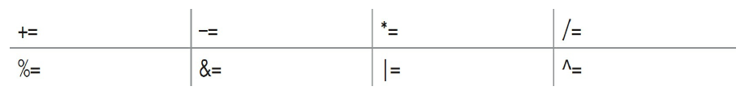
Shorthand Assignments
For example, x = x + 10 can be written as x += 10
Similarly, we have shorthand assignment operator as:

Slide 30
Type Conversion in Assignments
int i = 10;
float f = i; //A type conversion happens
When one type of data is assigned to another type of variable, an automatic type conversion will take place if:
Two types are compatible.
The destination type is larger than the source type

Slide 31

Automatic Type Conversion
public class LtoD {
public static void main(String[] args) {
// TODO Auto-generated method stub
long L = 100123285L;
double D = L;
System.out.println("L and D "+ L + " " + D);
}
}

Slide 32
Casting Incompatible Types
If you want to perform conversion between incompatible types, you may employ a cast.
A cast is an instruction to the compiler to convert one type into another by force.
General form of a cast:
(target-type)expression
double f = 1.66;
int i = (int)f; //A type conversion happens

Slide 33
public class CastDemo {
public static void main(String[] args) {
// TODO Auto-generated method stub
double x,y;
byte b;
int i;
char ch;
x=10.0; y=3.0;
i = (int)(x/y);
System.out.println("Integer outcome of x / y: " + i);
i = 100;
b = (byte)i;
System.out.println("Value of b: " + b);
i = 257;
b =(byte)i;
System.out.println("Value of b: " + b);
b = 88;
ch = (char)b;
System.out.println("ch: " + ch);
}
}

Slide 34
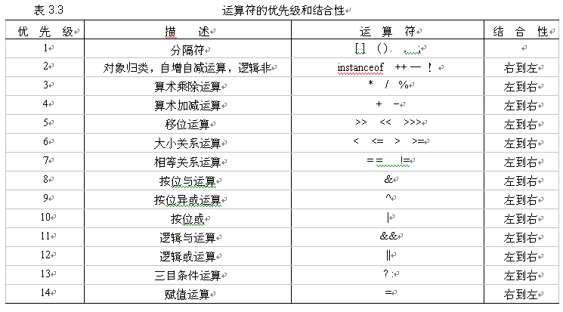
Operator Precedence

Slide 35
Type Conversion in Expressions
Java’s type promotion rules in an expression.
All char, byte and short values are promoted to int.
If one operand is long, the whole expression is promoted to long.
If one operand is float, the whole expression is promoted to float.
If any operand is double, the whole expression is promoted to double.
Examples:
If variable a is byte, b is short, c is char, then a+b+c is int.
If variable d is int, e is long, f is double, then d*e*f is double.

Slide 36
public class PromDemo {
public static void main(String[] args) {
// TODO Auto-generated method stub
byte b;
int i;
b = 10;
i = b * b; //OK, no cast needed
b = 10;
b = (byte)(b * b); //cast needed!
System.out.println("i and b: " + i + " " + b);
}
}

